Slide 1
Good Habits for Consumer Research MKTG 531 guest lecture Kellogg Research Support
January 13, 2023

Slide 2
Previous Experience
What do you do with your own data?
What do you find difficult about replicating other people’s work?

Slide 3
PART I – Replicability

Slide 4
Goals for Part I
Understand why replication is critical to your work
Learn 3 key principles for replication
See simple examples using R and KLC
https://github.com/rs-kellogg/MKTG_531

Slide 5
Who Cares About Replicating Results?
Co-authors and RAs
Referees of your paper
Readers of your paper
Journal editors, increasingly
Maybe most importantly to you, your future self!

Slide 6
Why Are Papers So Hard To Replicate?
Reproduction is difficult for the same reason collaboration can be difficult.
You and will need to…
… deploy multiple versions of your survey
… collect multiple waves of survey data and merge them correctly
… take steps to "clean" the raw data
… try out multiple regression specifications
… re-run models using different inclusion criteria
… transfer the results correctly into your paper
Or someone might…
... accidentally overwrite a file
... intentionally overwrite a file
... quit and take their procedural knowledge with them
… rely on software that your future self will not have

Slide 7

Will You Collaborate Well With Yourself?
10 years from now, will you be able to recreate every result from the paper you are about to write this quarter?
- or a paper where you and a coauthor split the work?
- or a paper that went through multiple rounds of R&R?
When you submit a paper to a journal, will you be ready to share your data?
- and working that will verify your results?
- and documentation that is unambiguous to someone else?
Will you be prepared to replicate you own work after you leave Northwestern?

Slide 8
3 Simple Principles for Replication
1. Automate Whenever Possible
2. Keep Good Records
3. Test, Test, Test!

Slide 9
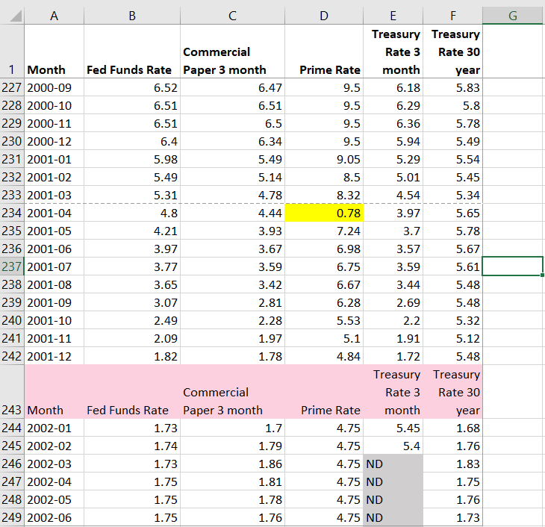
Automation Opportunities
You need to fix this flawed source data:
* Delete extra
* Move the decimal place in one cell
* Set ND to missing values
header rows
Why not just fix these issues in Excel?

Slide 10
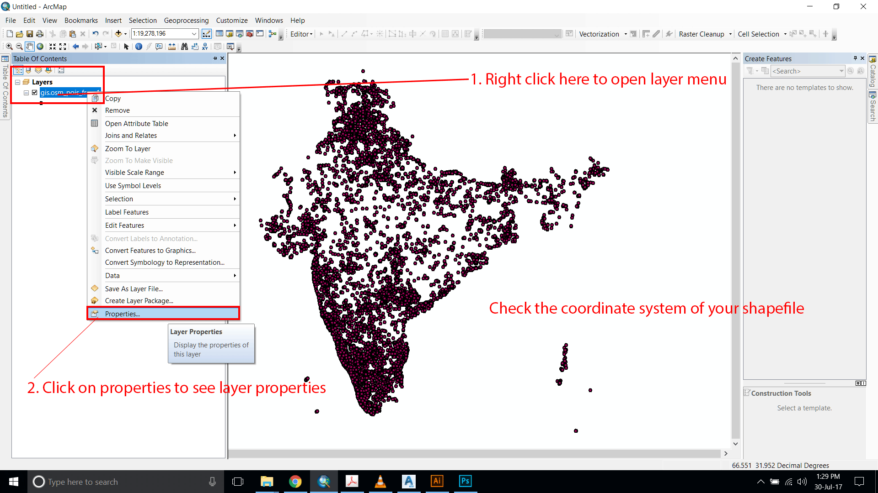
Automation Opportunities
Will you or your colleague be able to do this years from now?

Slide 11
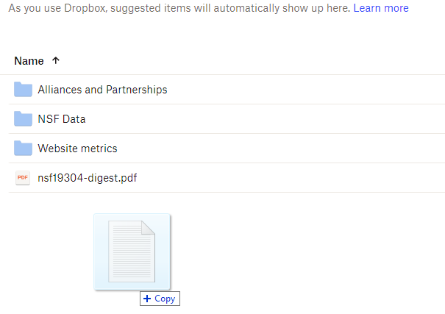
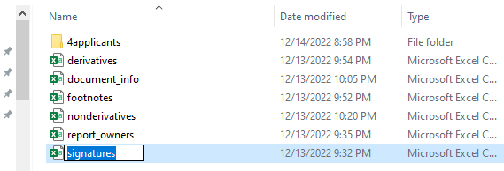
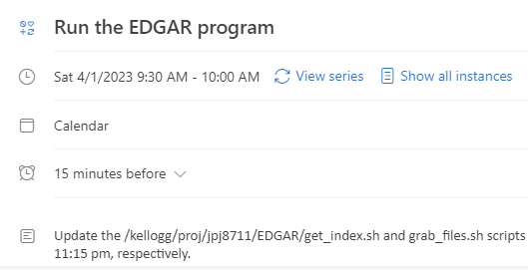
Automation Opportunities For You?

Slide 12
Good Records: Organize Directories
This was a real directory with code & data that Research Support used to monitor traffic load on the Kellogg Linux Cluster.
If you wanted to use this data, is it clear where to look?
active_netids.txt
active_usernames.txt
daily_email.sh
email_lookup.py
emails_of_active_users.sh
loadavg.gnuplot
loadavg_history.klc01.txt
loadavg_history.klc02.txt
loadavg_history.klc03.txt
loadavg_history.klc04.txt
loadavg_history.klc05.txt
loadavg.png
monitor_load.sh
netids_of_active_users.sh
renice/
users_history.klc01.txt
users_history.klc02.txt
users_history.klc03.txt
users_history.klc04.txt
users_history.klc05.txt
vmstat.gnuplot
vmstat_history.klc01.txt
vmstat_history.klc02.txt
vmstat_history.klc03.txt
vmstat_history.klc04.txt
vmstat_history.klc05.txt
vmstat.png

Slide 13
Good Records: Organize Directories
Suggestion: Use intuitive directory structures and file naming conventions.
monitoring/
README.txt
inputs/
outputs/
programs/
run_logs/
versions_old/
programs/
1_get_ps.py
2a_sum_users.py
2b_sum_load.py
3_make_graphs.py
4_send_email.py
RUN_ALL_PROGRAMS.sh

Slide 14
Good Records: Document Your Code
Document Everything!
Suggestion: Only document what you are willing to maintain constantly.

Slide 15
Good Records Don’t Repeat Themselves
Abstraction
Build your programs from modular code blocks
(a.k.a. functions, procedures, macros, subroutines, etc.)
Produce consistent, repeatable results across programs
Only one place needs documentation
Only one place needs testing, debugging

Slide 16
One Way People Repeat Themselves
use "/rawdata/2018/wages.dta, clear
keep if taxyear == 2018
generate lnwage = ln(wage)
Scatter lnwage tenure, title("ln(wages) versus Tenure, 2018")
regress lnwage educ gender tenure
regsave educ gender tenure using results,
table(OLS_stderr, order(regvars r2))
replace
use results, clear
outsheet using results_2018.txt, replace

Slide 17
Good Records: Version Control
Your Programs
Manage versions of your code with tools like git
Open Source Packages
Tools like conda
Computing Environments
Tools like Docker and Singularity (for preserving a KLC/Quest environment)

Slide 18
Testing
What you replicate must also be correct!
Suggestion: Assume your work has errors; take joy from finding them.
Make a list of testable propositions
Even things that shouldn't ever go wrong, could go wrong
Be imaginative

Slide 19
Summary
Incorporate programming into your work for efficiency and self-documentation.
Design your work as a series of modular tasks.
download data
examine contents
filter observations
make new fields
merge w/ existing data
calculate results
write results to paper
repeat last two steps
repeat them some more
log your activities
update documents
notify collaborators
Test each modular step in isolation.

Slide 20
Backup for Part I

Slide 21
Appendix – Text Editors on KLC
KLC has several text editors available for you to use. The links below provide the basic syntax for other text editors available to you:
Nano: From any terminal session on KLC, type:
nano <file_name>
https://www.redhat.com/sysadmin/getting-started-nano
Emacs: From any terminal session on KLC, type:
emacs <file_name>
https://www.redhat.com/sysadmin/beginners-guide-emacs
Vi: From any terminal session on KLC, type:
vi <file_name>
https://www.redhat.com/sysadmin/introduction-vi-editor

Slide 22
PART II – Open Science

Slide 23
Goals for Part II
Understand Open Science and why you should practice it
Identify Open Science in an article
Get acquainted with options for data / code repositories

Slide 24
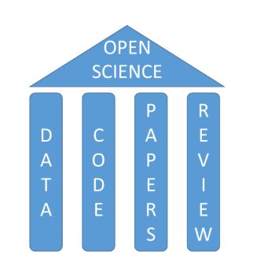
What is Open Science?
A collection of practices that make the content and process of producing evidence and claims transparent and accessible to others.
Concepts: openness, transparency, rigor, reproducibility, replicability, and accumulation of knowledge

Slide 25

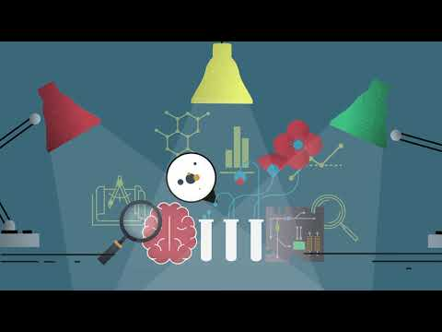
What is Open Science?
Center for Open Science

Slide 26
Why Open Science?
Principles
Inclusion, fairness, equity, and sharing
Goals
Reduce inequities in access to knowledge
Accelerate scientific progress and discoveries
Increase rigor, accountability, and reproducibility

Slide 27
Why Should *I* Practice Open Science?
Changing landscape of academic publication requirements
Traditional reward system
Transparency standards for journals
SAGE Publications
TOP Factor
Journal of Marketing

Slide 28
How do I Practice Open Science?
Think ahead
Reproducibility
Reduce collection of identifiable info
IRB language in sections:
Provisions to Protect Participant Privacy and Data Confidentiality
Long-term Data and Specimen Storage and Sharing
Use a data repository

Slide 29
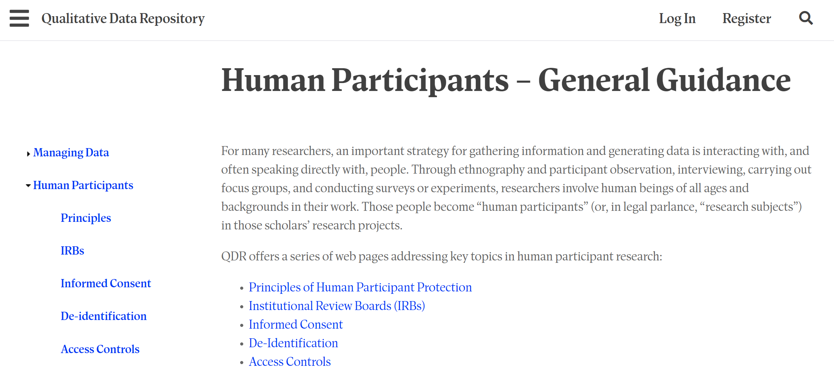
Qualitative Data Repository
Recommendations for sharing sensitive data, including audio-visual data
Notes:
ive data

Slide 30
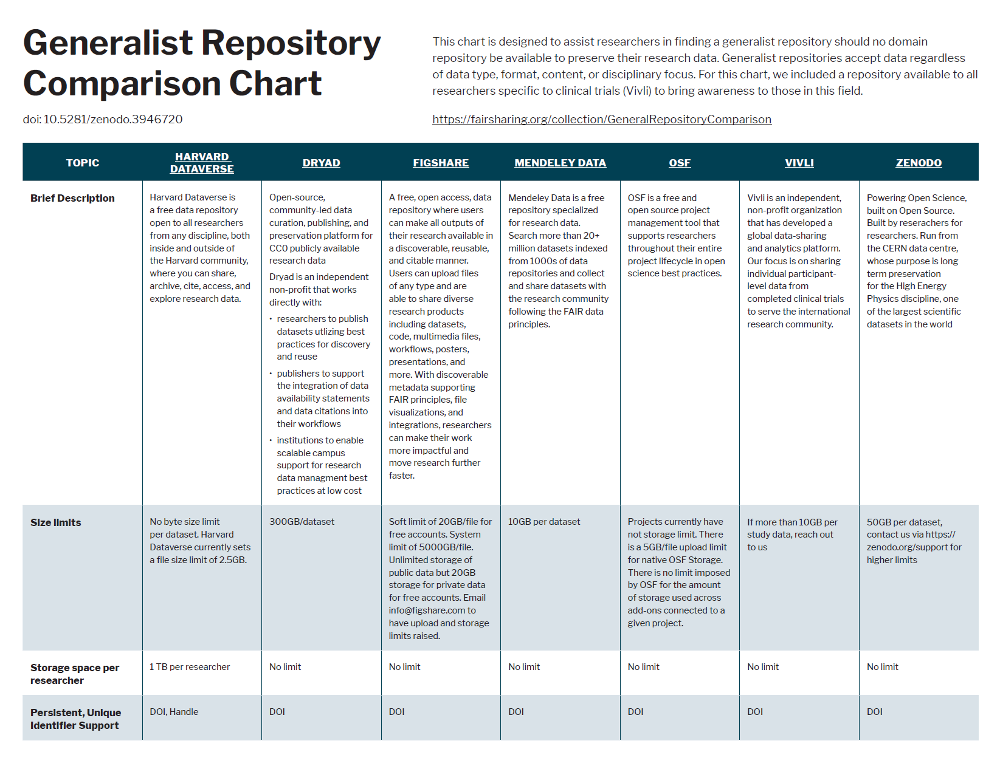

Slide 31
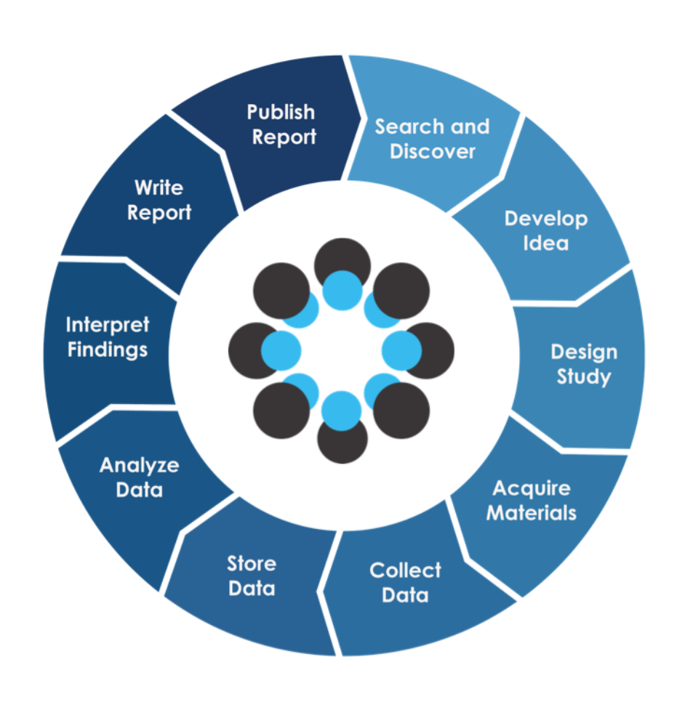
Data Repository Option: OSF
Open Science Framework from Center for Open Science

Slide 32
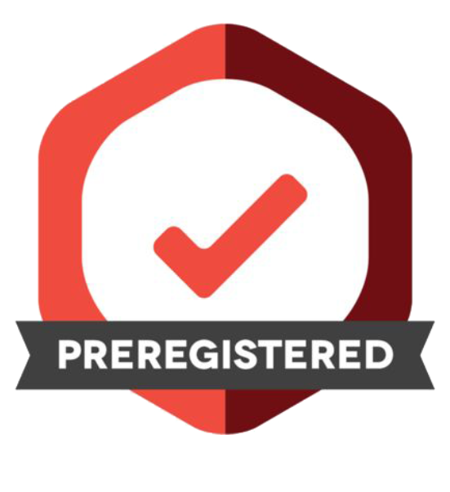
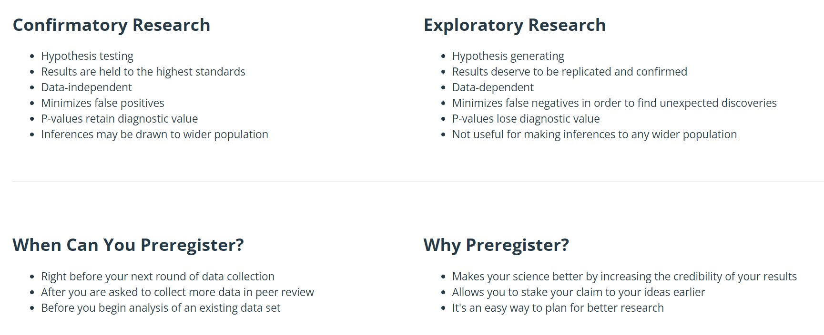
OSF Preregistration
Specify your research plan
Separate hypothesis-generating (exploratory) from hypothesis-testing (confirmatory) research
Notes:
ble research practice of “presenting a post hoc hypothesis in the introduction of a research report as if it were an a priori hypothesis”.[1][2]

Slide 33
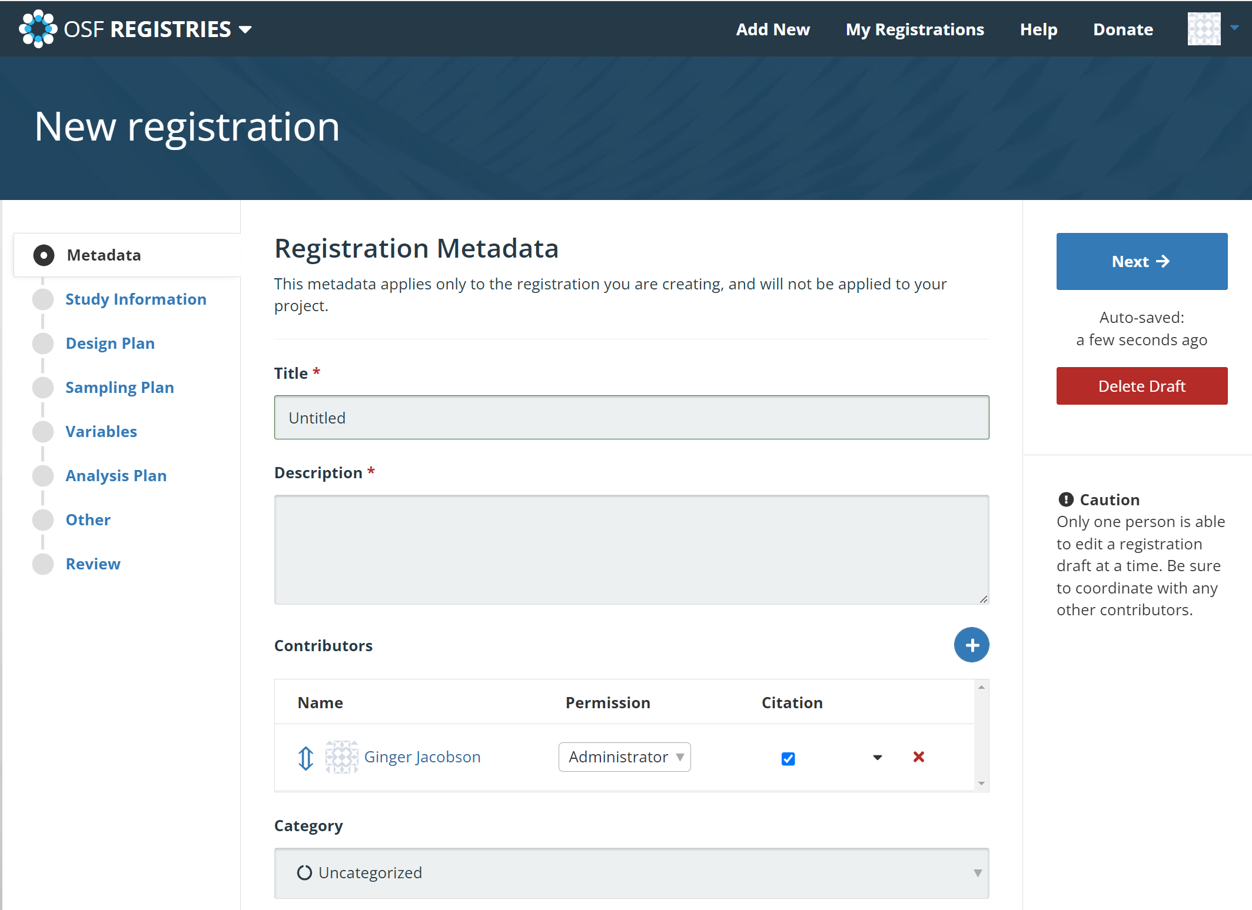
OSF Preregistration

Slide 34
Break

Slide 35
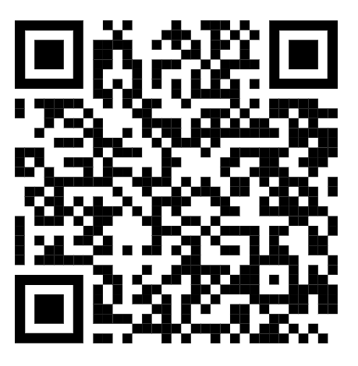
Exercise: Examine an OSF Project
Open the Dobson et al. Self-Dehumanization article
Are there any updates to this project?
What do the badges indicate?
What does the activity log tell you?
What does the pre-registration(s) tell you?
What data files are available?
Has anyone replicated this
study on OSF?

Slide 36
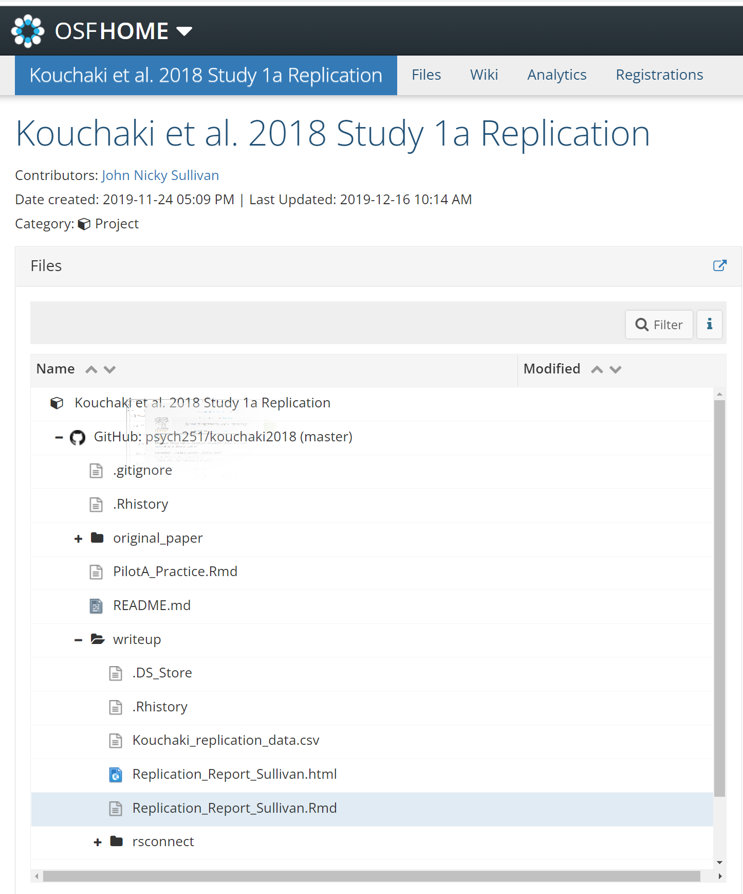
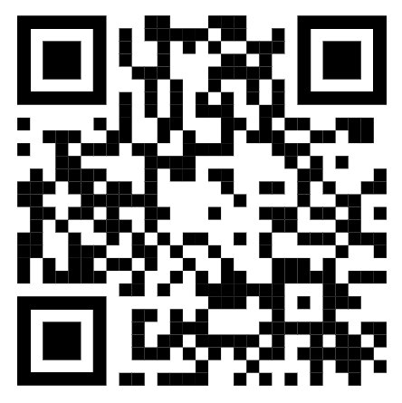
Exercise: Examine an Attempted Replication on OSF
John Nicky Sullivan: Kouchaki et al. 2018 Study 1a Replication

Slide 37
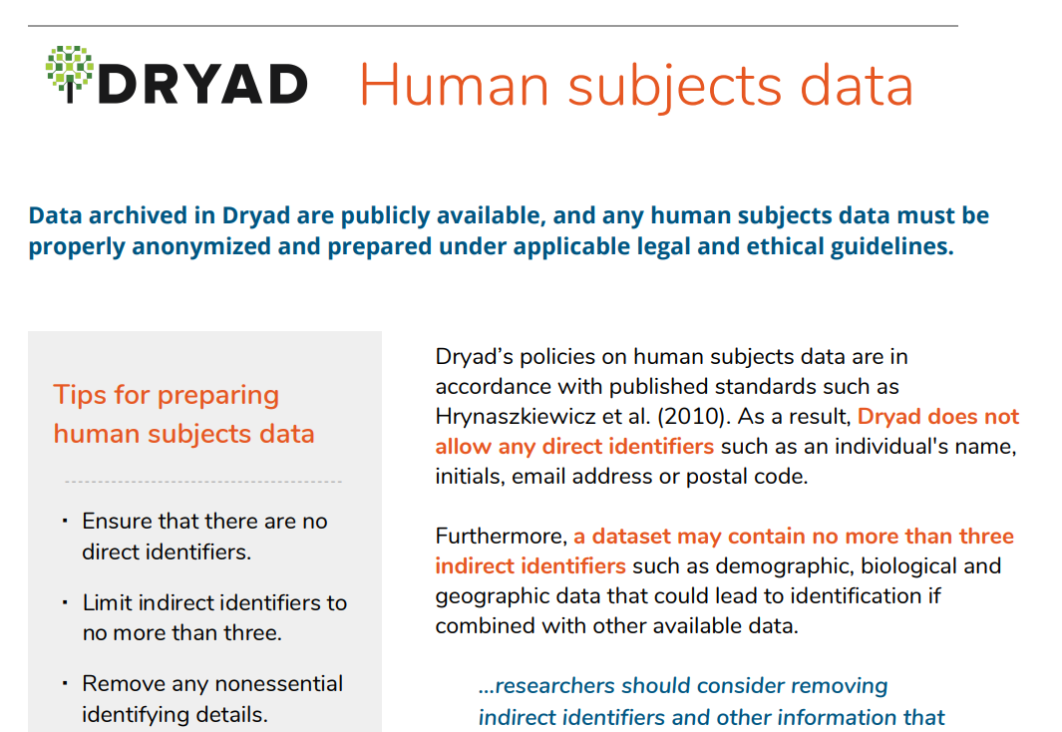
Data Repository Option: Dryad
Alternative to self-service: Curation and feedback on your uploaded files
Checks for:
human identifying or sensitive information
copyright/licensing
accessible ReadMe and file types

Slide 38
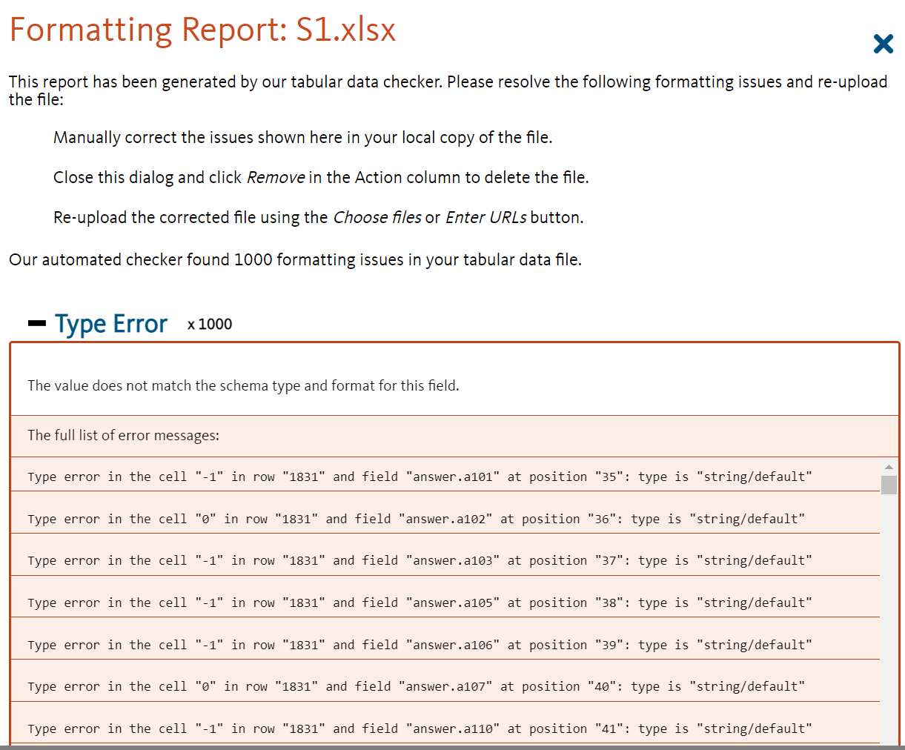
Data Repository Option: Dryad
Feedback on your uploaded files: Tabular data file

Slide 39
Data Repository Option: Dryad
You can update data, only the latest version will be visible. Prior versions can be accessed via the "Data Files" section.
Can I delete my data?
Data deposited in Dryad is intended to remain permanently archived and available. Removal of a deposited dataset is considered an exceptional action which should be requested and fully justified by the original contributor (e.g., if there are concerns over privacy or data ownership). To request the withdrawal of data from Dryad, contact help@datadryad.org.

Slide 40
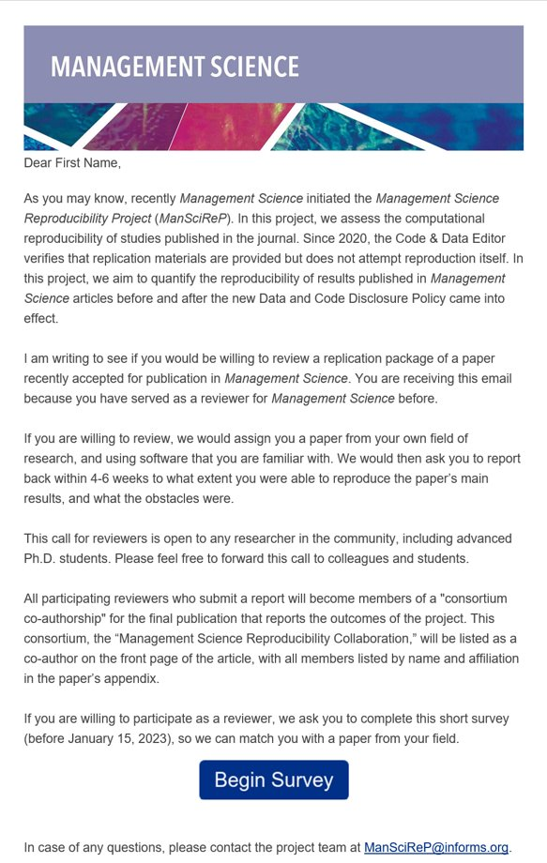
Open Science After Submission
Assess the reproducibility and replicability of studies
Improve analysis
Learning from mistakes

Slide 41
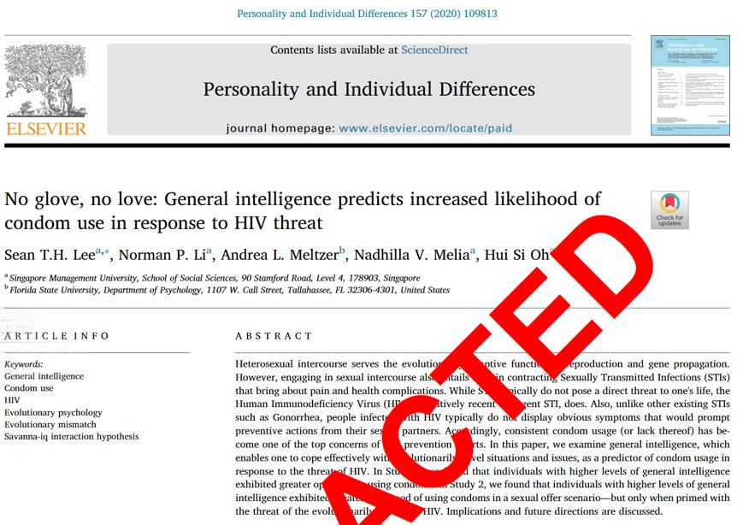
Retraction example 1
This article has been retracted at the request of the Editor in Chief of Personality and Individual Differences after concerns were raised with respect to the veracity of the data and analyses

Slide 42
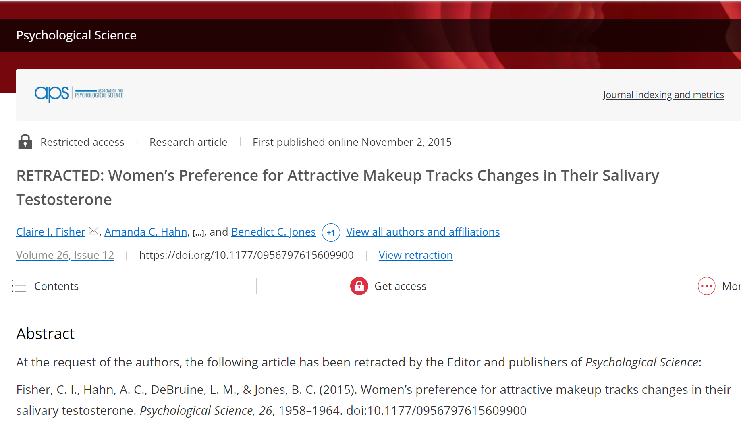
Retraction example 2
Editor’s Note: I would like to add an explicit statement that there is every indication that this retraction is entirely due to an honest mistake on the part of the authors.

Slide 43
Happy Researching!
Feel free to reach out:
John Johnson
John.johnson@kellogg.northwestern.edu
Ginger Jacobson
Ginger.jacobson@kellogg.northwestern.edu

Slide 44
Resources
An Introduction to OSF
Dryad Guide to Human Subjects Data
ICPSR and UCL guides to OS research
Seven easy steps to OS – article with an annotated reading list
Generalist Data Repository Grid

